Slide 1
H.api-Group
Simon, Ovidiu, Adam, Clifford & Sarah

Slide 2

<Introduction>
Crises seem to be an unavoidable part of our global economic system, affecting our society in unpredictable ways. We were motivated by the current health and financial crisis, to create a project that studies and analyses a critical part of everyone's lives: housing.

Slide 3
<Questions proposed>
What trends have the UK housing prices and sales followed for the past 16 years?
How have they been affected by the 2008 financial crash and Covid-19?
Where are housing prices and sales volume highest in the UK?
Using the most recent data from July 2021
Where is the highest sales volume and housing price within the West Midlands?
How does the West Midlands compare with the other regions of England when it comes to housing prices and purchase volume?
A comparison between Birmingham, Coventry, Dudley, Sandwell, Solihull, Walsall, Wolverhampton, using the most recent data (July 2021)

Slide 4


<Data used>
A collection of data of the UK housing market starting from 2005.
Analysis of the average house prices, sales, number of houses and different type of housing.
Divided by country, cities, regions and counties, to that extends until July 2021.

Slide 5
<Average prices of housing in the uk>

Slide 6
Year
Price

Slide 7
<Average house price in the uk > (Over the past 12 years)
Price
Date

Slide 8
<What can we gather from the data?>
In 2008 during global financial crisis, UK prices fell from a high average price of £184,000 in late 2007, to a low of just under £150,000 in early 2009.
House prices fell by 16% in 2008. They did not return to the higher level until mid-2014.
During the 2008 financial crisis, property fell in value by up to 20% in UK. Average price recovered in 2014.
Average UK property value is £252,687 currently, and they are 10% higher than a year earlier.
House prices have risen to almost 15% above levels seen in March 2020 when the coronavirus pandemic first struck the UK.

Slide 9
<Sales Volume>

Slide 10
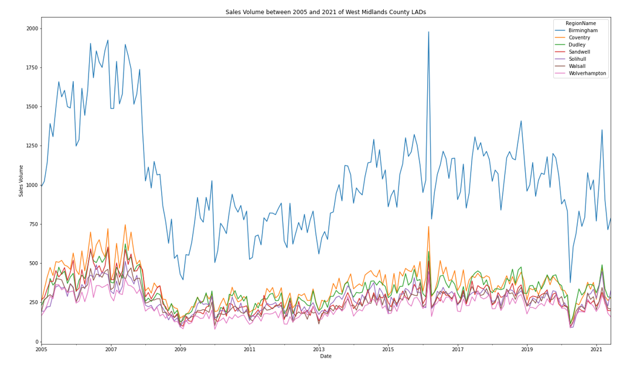

Slide 11
<What can we gather from these trends?> (January 2005 and July 2021)
The highest number of transactions was March 2016 in Birmingham, 1978 sales, whilst Wolverhampton with a total sales of 78 house in January 2010 is the lowest.
April 2020 was the lowest month for WM County LAD’s house sales since 2009, caused by impacts from the Covid-19 pandemic.
Between 2010 and Feb 2020, WM County LAD’s house transactions followed a seasonal, but generally stable trend.
There was a very large peak in March 2016 caused by significantly increased transaction completions before the introduction of higher rates for additional properties from April 2016.
The fall in transactions from late 2007 coincided with the financial crisis, before which transactions had increased steadily before peaking in mid 2006.

Slide 12
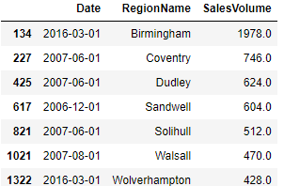
<Top Sales Volume Within the West Midlands Counties>

Slide 13
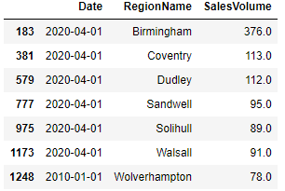
<Lowest Sales Volume Within the West Midlands counties >

Slide 14
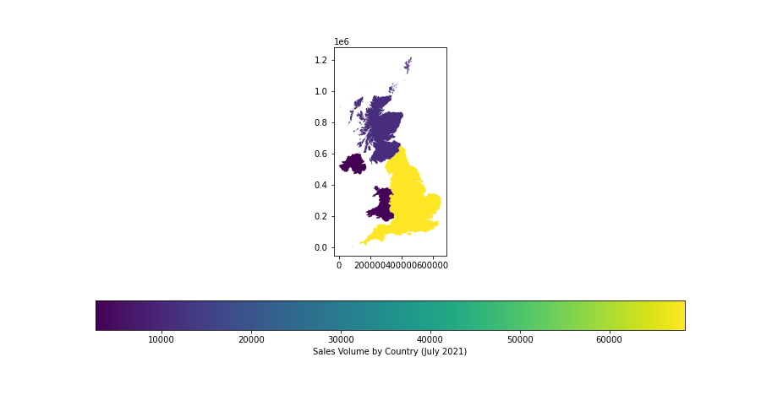
<In the uk>
England had the highest number of sales in July 2021 (14,215), followed by Scotland with a total transactions of 10,667, while Wales registered the lowest numbers of transactions, 1,008.

Slide 15
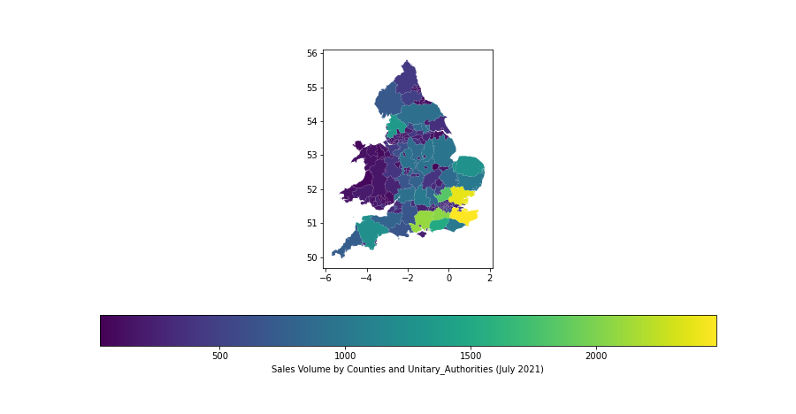
<by counties>

Slide 16
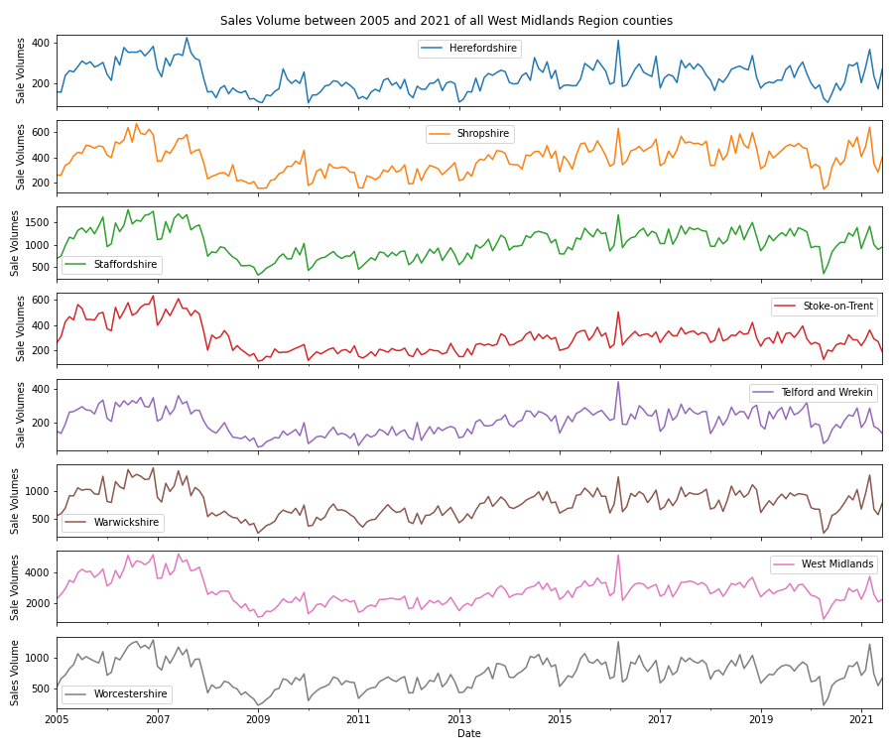
<Within The West Midlands>
Sales Animation

Slide 17
<Average price vs sale comparison>

Slide 20
<Where is the highest sales volume and housing price within the West Midlands?>
By the end of Q3 2021 most property sales in West Midlands involved semi-detached properties . A total of 14 275 were sold with average of £233,359.
Detached properties sold for an average price of £408,892, while terraced and flats fetched £194,109 and £150,312, respectively.
West Midlands county, with an overall average price of £268,973 was more expensive than nearby East Midlands (£251,117) and Northwest (£236,640), but was cheaper than Southwest (£342,135).
The highest priced area within West Midlands was Warwickshire (£334,741) and the least expensive was Stoke-on-Trent (£146,853).
During the last year, average prices in West Midlands were 6,55% up from the previous year and 1,68% up from 2018 when the average house price was £227,496.

Slide 21
< Cities within the West Midlands>

Slide 22
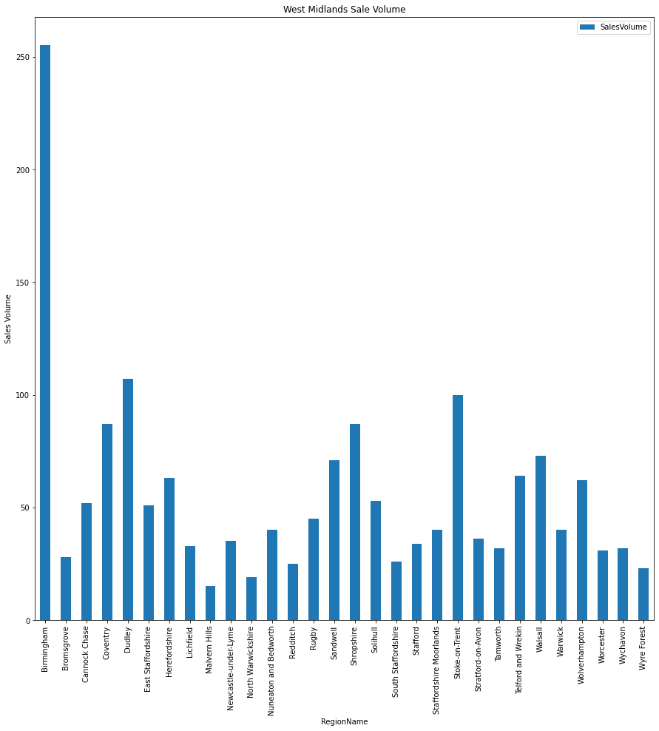
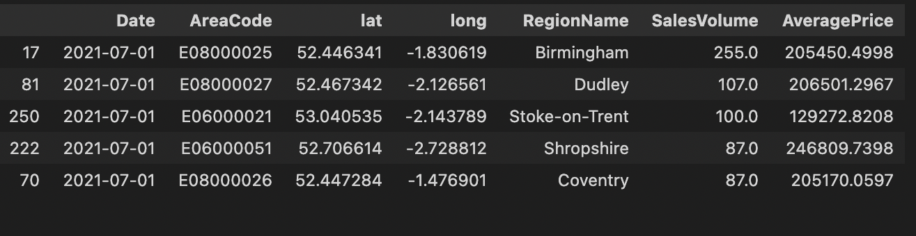
<Top Sales Volume Within West Midlands Cities>
July 2021
Sales volume in the West Midlands is highest in the City of Birmingham with 255 houses sold in July 2021 and an average price of £205450.50

Slide 23
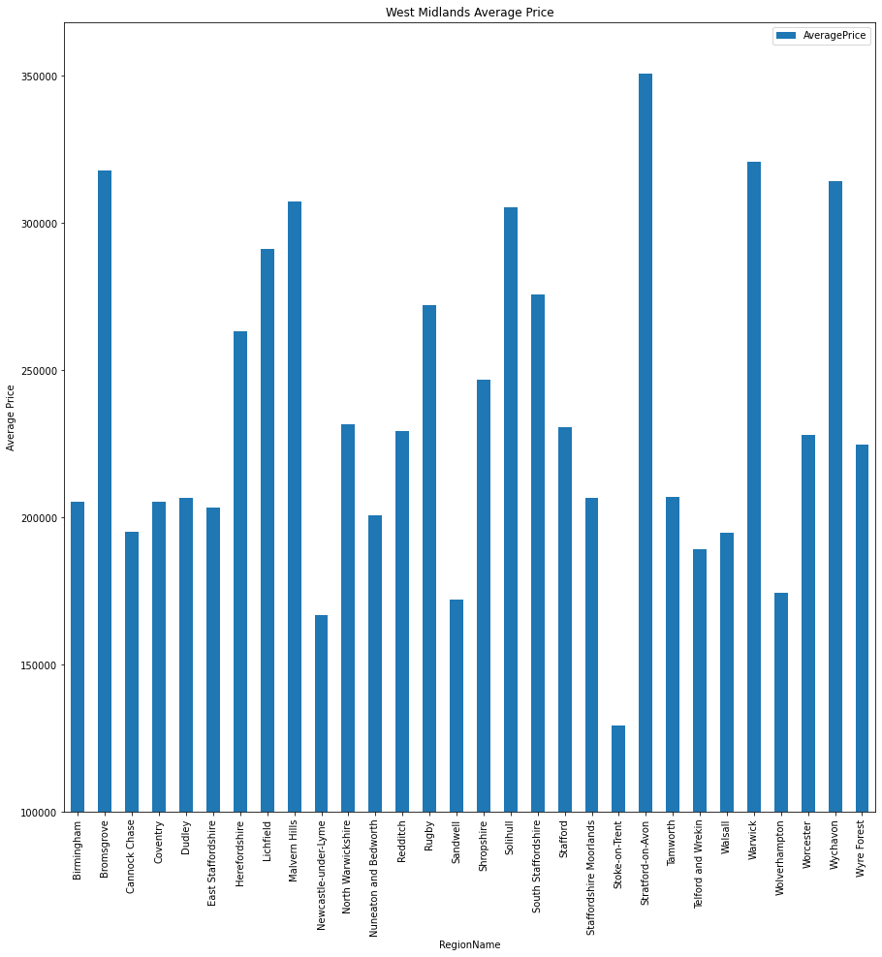
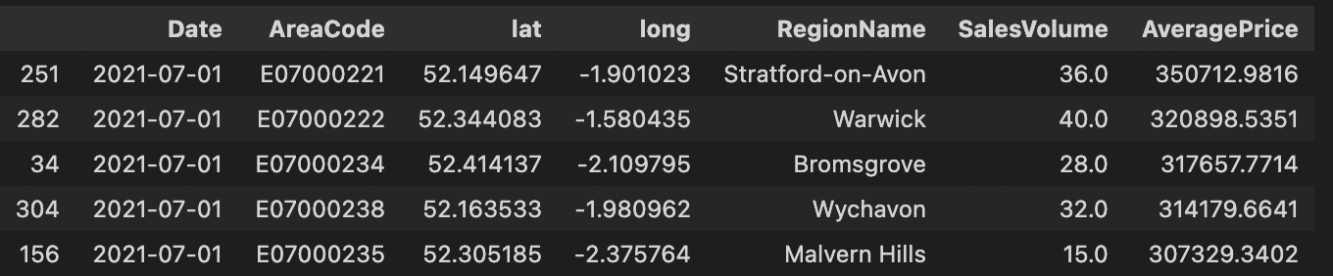
<Top Average Pricing Within West Midlands Cities> July 2021
Whereas Average Price is highest in Stratford Upon Avon £350712.98 with only 36 houses sold in July 2021

Slide 24
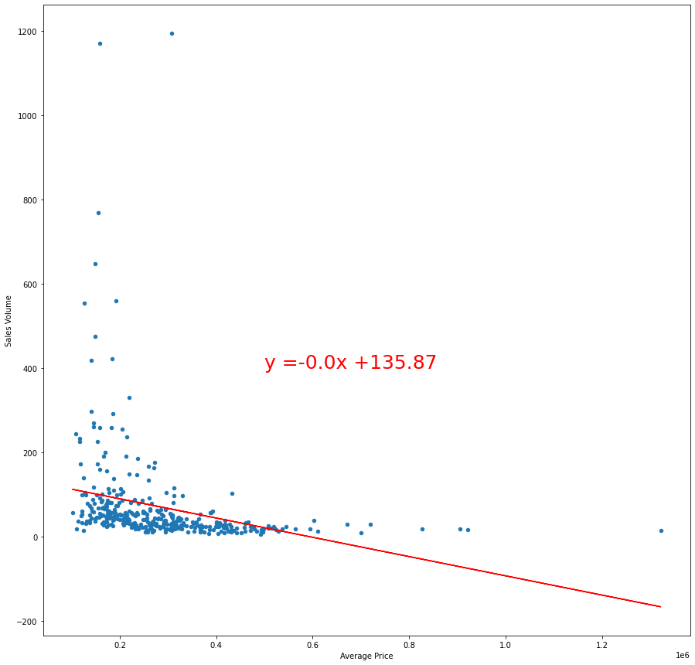
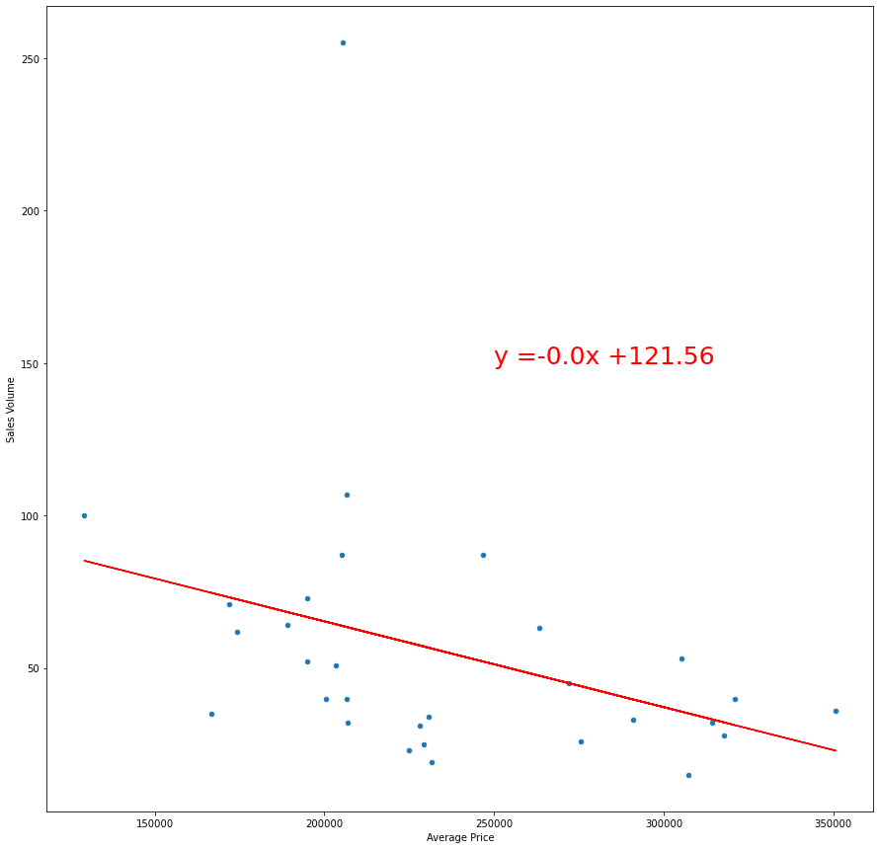
<Does The Increase In House Pricing Affect Sales Volume?>
<UK>
<Cities in West Midlands>
The UK has a negative correlation; however, it has an r-value of 0.069 and a p-value of 1.32.
Birmingham has a negative correlation; however, it has an r-value of 0.12 and a p-value of 1.75

Slide 25
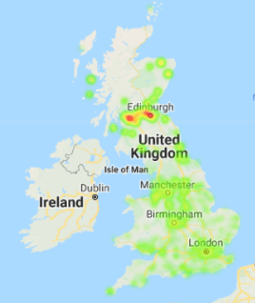
<UK Top Sales volume>
The top UK Sales volume has been seen in the City of Edinburgh with 1194 houses sold in July 2021 this month with an average price of £306,911.32.

Slide 26
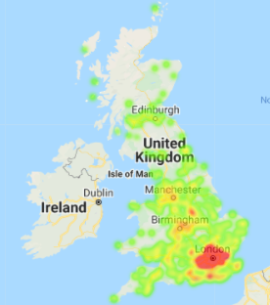
<UK Top Average price>
The top UK Average price has been seen in Kensington and Chelsea £1,321,924 with average sale volume of 15 houses sold houses sold in July 2021.

Slide 27
<Conclusions and findings>

Slide 28
<What trends have the UK housing prices and sales followed for the past 16 years?>
Housing Price
Since 2005 the housing price has increased till 2008.
However, during the financial crisis there was a reduction of 8.33%.
In 2019 to 2020 the UK housing price increased by 3.11%.
In 2020 to 2021 the UK housing price increased by 8%.
Sales Volume
There was a large increase of sales volume from 2005 to 2006 and a very sharp reduction from 2007 to 2008 by 92.8% in the UK.
In 2019 to 2020 the UK sales volume decreased by 20.4%.
In 2020 to 2021 the UK sales volume decreased by 54.3%.

Slide 29
<Where are housing prices and sales volume highest in the UK?>
Housing Price
The top UK Average price has been seen in Kensington and Chelsea £1,321,924 in July 2021, 84% higher than Birmingham.
Sales Volume
The top UK Sales volume has been seen in the City of Edinburgh with 1194 houses sold in July 2021, 81% higher than Birmingham.

Slide 30
<Where is the highest sales volume and house price within the West Midlands?> (July 2021)
Housing Price
Stratford Upon Avon has the highest Average Price of £350713, 41% higher than Birmingham.
Sales Volume
The City of Birmingham has the highest sales volume with 225 houses sold per month.

Slide 31
<The West Midlands vs other regions of England: housing prices and purchase volume>
Housing Price
Warwickshire had the highest Average house price of £334,741 and only 4951 sales per month, 26% higher than West Midlands. 39% higher than in Birmingham.
Sales Volume
The West Midlands had the highest Sales volume out of all the regions with 16,299, 42% more than the second highest region Staffordshire and had an average price of £248,439. 17% higher than Birmingham.

Slide 32
<Findings> (July 2021)
Birmingham is 4.6% lower than the average housing price in the UK.
24.8% lower than the English average house price.
17% lower than West Midlands average price.
11th lowest house price out of 30.
41% lower then the highest city in the West Midlands.
Birmingham has increased by £11810 5.9% since 2019.
2.1% less than the UK increase.
Even with the events of the Covid-19 pandemic the sales volume in the UK have increased by 11.7% from 2020.
However, there has been a reduction of sales volume by 9.3% since before the outbreak of Covid- 19.
Nevertheless, sales volume has not been affected by the increase in house prices.

